Slide 1
What happens when...
you type google.com into your browser's address box and press enter?

Slide 2
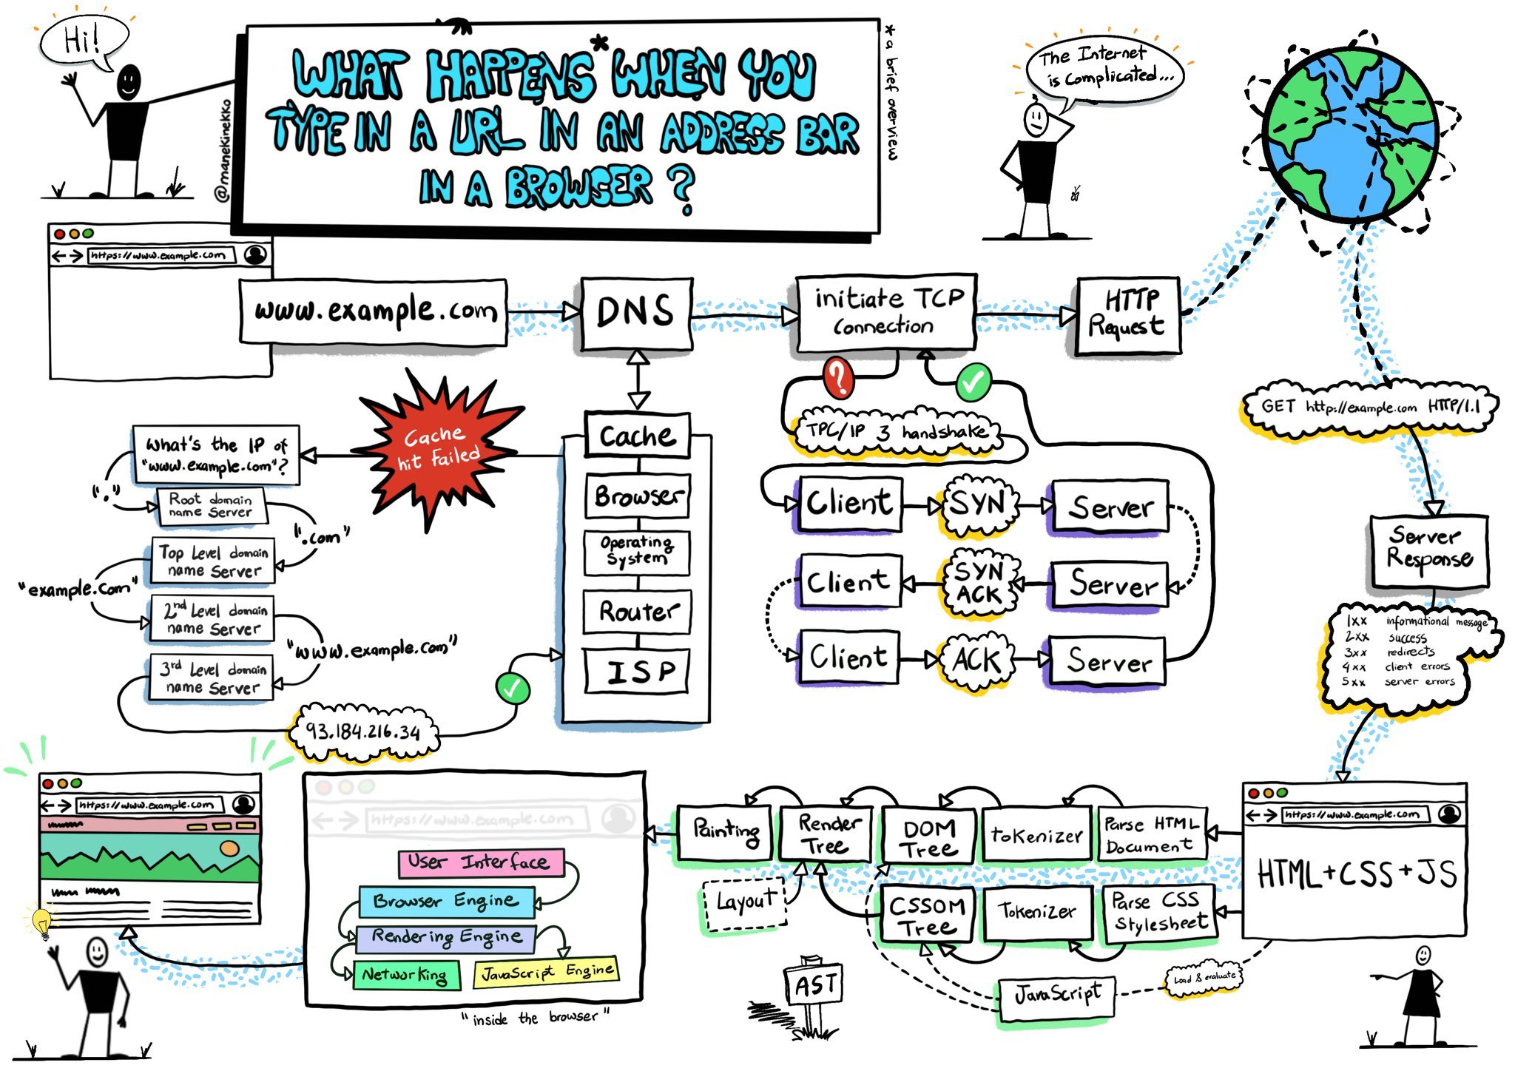
Main flow

Slide 3
Main flow: typing and parsing URL
Notes:
The following sections explain the physical keyboard actions and the OS interrupts.

Slide 4
The "g" key is pressed...
The browser receives the event and the auto-complete functions kick in. Suggestions are presented in the dropdown below the URL bar based on:
Private/incognito mode
Search history
Bookmarks
Cookies
Popular searches from the internet as a whole

Slide 5
2. The "enter" key bottoms out
The keyboard sends signals on its interrupt request line (IRQ) -> CPU runs the appropriate handler
(On Windows) A WM_KEYDOWN message is sent to the app
(On OS X) A KeyDown NSEvent is sent to the app
(On GNU/Linux) the Xorg server listens for keycodes

Slide 6
3. Parse URL
The browser now has the following information contained in the URL (Uniform Resource Locator):
Protocol "http" - use 'Hyper Text Transfer Protocol'
Resource "/" - retrieve main (index) page

Slide 7
3.1 Is it a URL or a search term?
When no protocol or valid domain name is given the browser proceeds to feed the text given in the address box to the browser's default web search engine.
Domain name is given in our case

Slide 8
3.2 Convert non-ASCII Unicode characters in hostname
The browser checks the hostname for characters that are not in a-z, A-Z, 0-9, -, or ..
Since the hostname is google.com there won't be any, but if there were the browser would apply Punycode encoding to the hostname portion of the URL

Slide 9
3.3 Check HSTS list
The browser checks its "preloaded HSTS (HTTP Strict Transport Security)" list. This is a list of websites that have requested to be contacted via HTTPS only.
If the website is in the list, the browser sends its request via HTTPS instead of HTTP. Otherwise, the initial request is sent via HTTP.

Slide 10
Main flow: DNS lookup
Notes:
Getting an IP address by Domain name

Slide 11
4. DNS lookup
Check if domain exists in cache
If not found, the browser calls gethostbyname library function to do the lookup
Gethostbyname check hosts file (before trying to resolve the hostname through DNS)
Gethostbyname makes a request to the DNS server configured in the network stack (this is typically the local router or the ISP's caching DNS server)
The network library follows ARP process:
for the DNS server (if the DNS server is on a same subnet)
for the default gateway IP (if the DNS server is on a different subnet)
Notes:
Browser checks if the domain is in its cache
If not found, the browser calls gethostbyname library function to do the lookup.
gethostbyname checks if the hostname can be resolved by reference in the local hosts file before trying to resolve the hostname through DNS
If gethostbyname does not have it cached nor can find it in the hosts file then it makes a request to the DNS server configured in the network stack. This is typically the local router or the ISP's caching DNS server.
If the DNS server is on the same subnet the network library follows the ARP process below for the DNS server.
If the DNS server is on a different subnet, the network library follows the ARP process below for the default gateway IP.

Slide 12
ARP process: required data
In order to send an ARP (Address Resolution Protocol) broadcast the network stack library needs:
the target IP address to look up
the MAC address of the interface it will use to send out the ARP broadcast

Slide 13
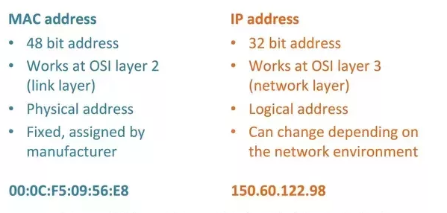
MAC address vs IP address

Slide 14
ARP process: flow
The ARP cache is first checked for an ARP entry for our target IP.
If it is in the cache, the library function returns the result: Target IP = MAC.
If the entry is not in the ARP cache:
The route table is looked up, to see if the Target IP address is on any of the subnets on the local route table. If it is, the library uses the interface associated with that subnet. If it is not, the library uses the interface that has the subnet of our default gateway.
The MAC address of the selected network interface is looked up.
The network library sends a Layer 2 ARP request

Slide 15
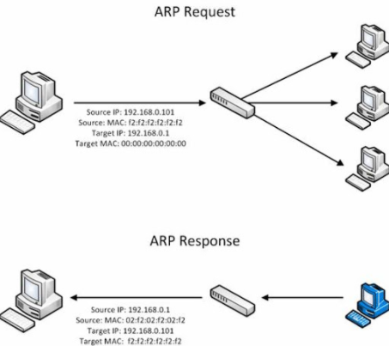
4.4 ARP request and reply
APR request:
Sender MAC: interface:mac:address:here
Sender IP: interface.ip.goes.here
Target MAC: FF:FF:FF:FF:FF:FF (Broadcast)
Target IP: target.ip.goes.here
APR reply
Sender MAC: target:mac:address:here
Sender IP: target.ip.goes.here
Target MAC: interface:mac:address:here
Target IP: interface.ip.goes.here
Notes:
Depending on what type of hardware is between the computer and the router:
Directly connected:
If the computer is directly connected to the router the router responds with an ARP Reply (see below)
Hub:
If the computer is connected to a hub, the hub will broadcast the ARP request out all other ports. If the router is connected on the same "wire", it will respond with an ARP Reply (see below).
Switch:
If the computer is connected to a switch, the switch will check its local CAM/MAC table to see which port has the MAC address we are looking for. If the switch has no entry for the MAC address it will rebroadcast the ARP request to all other ports.
If the switch has an entry in the MAC/CAM table it will send the ARP request to the port that has the MAC address we are looking for.
If the router is on the same "wire", it will respond with an ARP Reply (see below)

Slide 16
4.5 DNS process resuming
Now that the network library has the IP address it can resume its DNS process:
The DNS client establishes a socket to UDP port 53 on the DNS server, using a source port above 1023.
If the response size is too large, TCP will be used instead.
If the local/ISP DNS server does not have it, then a recursive search is requested and that flows up the list of DNS servers until the SOA is reached, and if found an answer is returned.

Slide 17
5 Opening of a socket
Once the browser receives the IP address of the destination server, it takes that and the given port number from the URL (the HTTP protocol defaults to port 80, and HTTPS to port 443), and makes a call to the system library function named socket and requests a TCP socket stream - AF_INET/AF_INET6 and SOCK_STREAM.
This request is first passed to the Transport Layer where a TCP segment is crafted (the destination port is added to the header, and a source port is chosen from within the kernel's dynamic port range)
This segment is sent to the Network Layer
The packet next arrives at the Link Layer
At this point the packet is ready to be transmitted through:
Ethernet
WiFi
Cellular data network
Eventually, the packet will reach the router managing the local subnet. From there, it will continue to travel to the autonomous system's (AS) border routers, other ASes, and finally to the destination server.
This send and receive happens multiple times following the TCP connection flow
Notes:
Когда браузер получает IP-адрес конечного сервера, то он берёт эту информацию и данные об используемом порте из URL (80 порт для HTTP, 443 для HTTPS) и осуществляет вызов функции socket системной библиотеки и запрашивает поток TCP сокета — AF_INET и SOCK_STREAM.
Этот запрос сначала проходит через транспортный уровень, где собирается TCP-сегмент. В заголовок добавляется порт назначения, исходный порт выбирается из динамического пула ядра (ip_local_port_range в Linux).
Получившийся сегмент отправляется на сетевой уровень, на котором добавляется дополнительный IP-заголовок. Также включаются IP-адрес сервера назначения и адрес текущей машины — после этого пакет сформирован.
Пакет передаётся на канальный уровень. Добавляется заголовок кадра, включающий MAC-адрес сетевой карты (NIC) компьютера, а также MAC-адрес шлюза (локального роутера). Как и на предыдущих этапах, если ядру ничего не известно о MAC-адресе шлюза, то для его нахождения отправляется широковещательный ARP-запрос.

Slide 18
Main flow: TCP Connection
Notes:
Getting an IP address by Domain name

Slide 19
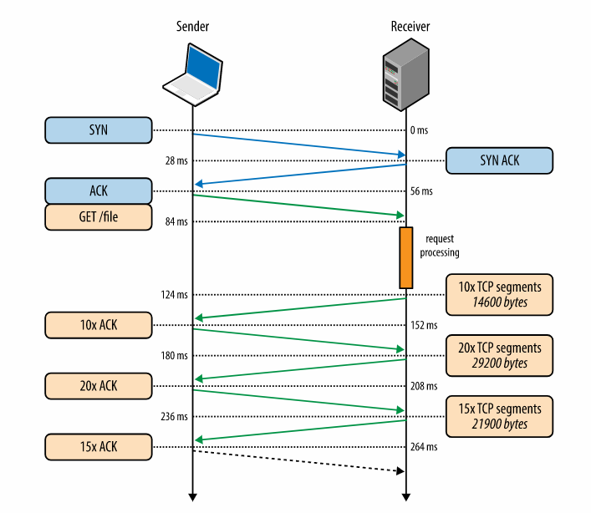
5.1 TCP connection flow
Client chooses an initial sequence number (ISN) and sends the packet to the server with the SYN bit set to indicate it is setting the ISN
Server receives SYN and if it's in an agreeable mood
Client acknowledges the connection
Data is transferred
Connection is closed
Notes:
5.1 Жизненный цикл TCP-соединения
a. Клиент выбирает номер начальной последовательности (ISN) и отправляет пакет серверу с установленным битом SYN для открытия соединения.
b. Сервер получает пакет с битом SYN и, если готов к установлению соединения, то:
Выбирает собственный номер начальной последовательности;
Устанавливает SYN-бит, чтобы сообщить о выборе начальной последовательности;
Копирует ISN клиента +1 в поле ACK и добавляет ACK-флаг для обозначения подтверждения получения первого пакета.
c. Клиент подтверждает соединение путём отправки пакета:
Увеличивает номер своей начальной последовательности;
Увеличивает номер подтверждения получения;
Устанавливает поле ACK.
d. Данные передаются следующим образом:
Когда одна сторона отправляет N байтов, то увеличивает значение поля SEQ на это число.
Когда вторая сторона подтверждает получение этого пакета (или цепочки пакетов), она отправляет пакет ACK, в котором значение поля ACK равняется последней полученной последовательности.
e. Закрытие соединения:
Сторона, которая хочет закрыть соединение, отправляет пакет FIN;
Другая сторона подтверждает FIN (с помощью ACK) и отправляет собственный FIN-пакет;
Инициатор прекращения соединения подтверждает получение FIN отправкой собственного ACK.

Slide 20
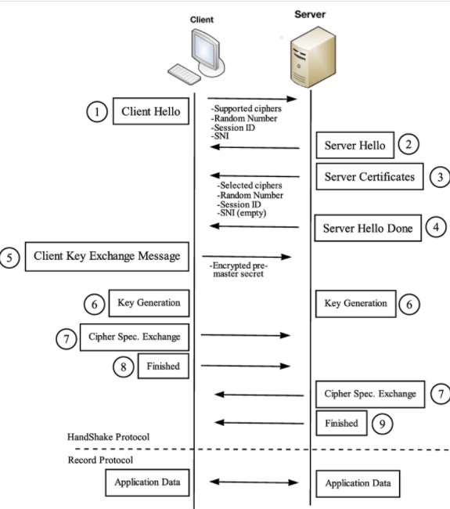
6 TLS handshake
Notes:
The purpose of the SSL/TLS handshake is to perform all the cryptographic work needed to have a secure connection. This includes authenticating the SSL certificate being used, and generating an encryption key. ... Authenticating one or both parties. Creating/Exchanging symmetric session keys
The client computer sends a ClientHello message to the server with its Transport Layer Security (TLS) version, list of cipher algorithms and compression methods available.
The server replies with a ServerHello message to the client with the TLS version, selected cipher, selected compression methods and the server's public certificate signed by a CA (Certificate Authority). The certificate contains a public key that will be used by the client to encrypt the rest of the handshake until a symmetric key can be agreed upon.
The client verifies the server digital certificate against its list of trusted CAs. If trust can be established based on the CA, the client generates a string of pseudo-random bytes and encrypts this with the server's public key. These random bytes can be used to determine the symmetric key.
The server decrypts the random bytes using its private key and uses these bytes to generate its own copy of the symmetric master key.
The client sends a Finished message to the server, encrypting a hash of the transmission up to this point with the symmetric key.
The server generates its own hash, and then decrypts the client-sent hash to verify that it matches. If it does, it sends its own Finished message to the client, also encrypted with the symmetric key.
From now on the TLS session transmits the application (HTTP) data encrypted with the agreed symmetric key.

Slide 21
Main flow: HTTP request and respond
Notes:
Getting an IP address by Domain name

Slide 22
7.1 HTTP protocol: client request
Google Chrome, instead of sending an HTTP request to retrieve the page, sends a request to try and negotiate with the server an "upgrade" from HTTP to the SPDY protocol.
If the client is using the HTTP protocol and does not support SPDY, it sends a request to the server of the form:
GET / HTTP/1.1
Host: google.com
Connection: close
[other headers]
where [other headers] refers to a series of colon-separated key-value pairs formatted as per the HTTP specification and separated by single new lines.
HTTP/1.1 defines the "close" connection option for the sender to signal that the connection will be closed after completion of the response. For example, Connection: close (HTTP/1.1 applications that do not support persistent connections MUST include the "close" connection option in every message.)
After sending the request and headers, the web browser sends a single blank newline to the server indicating that the content of the request is done.

Slide 23
7.2 HTTP protocol: server respond
The server responds with a response code denoting the status of the request and responds with a response of the form:
200 OK
[response headers]
Followed by a single newline
Payload of the HTML content of www.google.com
304 Not Modified and HTML it used from cache, if the web browser has been unmodified since the last retrieval
Server may close a connection
The web browser (and server) repeats this process for every resource (image, CSS, favicon.ico, etc) referenced by the HTML page

Slide 24
7.3 HTTP Server Request Handle
The HTTPD (HTTP Daemon) server is the one handling the requests/responses on the server side
The HTTPD receives the request
The server breaks down the request to the following parameters
HTTP Request Method (either GET, HEAD, POST, PUT...). In the case of a URL entered directly into the address bar, this will be GET.
Domain, in this case - google.com.
Requested path/page, in this case - / (as no specific path/page was requested, / is the default path).
The server verifies that there is a Virtual Host configured on the server that corresponds with google.com.
The server verifies that google.com can accept GET requests.
The server verifies that the client is allowed to use this method (by IP, authentication, etc.)
If the server has a rewrite module installed, it tries to match the request against one of the configured rules.
The server goes to pull the content that corresponds with the request
The server parses the file according to the handler

Slide 25
Main flow: Behind the scenes of the Browser
Notes:
Getting an IP address by Domain name

Slide 26
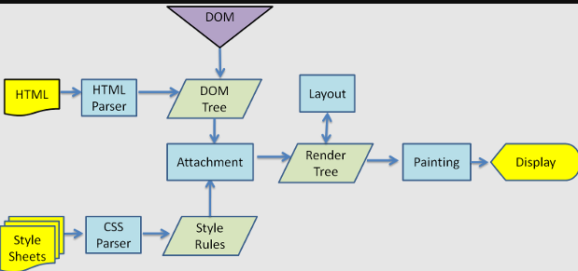
8 Behind the scenes of the Browser
Parsing - HTML, CSS, JS
Rendering - Construct DOM Tree → Render Tree → Layout of Render Tree → Painting the render tree

Slide 27
8.1 Browser
The browser's functionality is to present the web resource you choose, by requesting it from the server and displaying it in the browser window The way the browser interprets and displays HTML files is specified in the HTML and CSS specifications. These specifications are maintained by the W3C organization
The common user interface elements are:
An address bar for inserting a URI
Back and forward buttons
Bookmarking options
Refresh and stop buttons for refreshing or stopping the loading of current documents
Home button that takes you to your home page

Slide 28
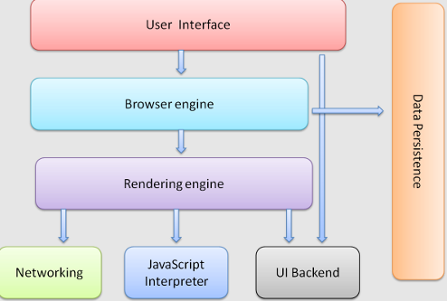
8.2 Browser High Level Structure
User interface
Browser engine
Rendering engine
Networking
UI backend
JavaScript engine
Data storage (e. g. to store cookie)
Notes:
User interface: The user interface includes the address bar, back/forward button, bookmarking menu, etc. Every part of the browser display except the window where you see the requested page.
Browser engine: The browser engine marshals actions between the UI and the rendering engine.
Rendering engine: The rendering engine is responsible for displaying requested content. For example if the requested content is HTML, the rendering engine parses HTML and CSS, and displays the parsed content on the screen.
Networking: The networking handles network calls such as HTTP requests, using different implementations for different platforms behind a platform-independent interface.
UI backend: The UI backend is used for drawing basic widgets like combo boxes and windows. This backend exposes a generic interface that is not platform specific. Underneath it uses operating system user interface methods.
JavaScript engine: The JavaScript engine is used to parse and execute JavaScript code.
Data storage: The data storage is a persistence layer. The browser may need to save all sorts of data locally, such as cookies. Browsers also support storage mechanisms such as localStorage, IndexedDB, WebSQL and FileSystem.

Slide 29
9 HTML parsing
The rendering engine gets the contents of the requested document from the networking layer
HTML markup is parsed into a parse tree of DOM element and attribute nodes
The parsing algorithm consists of two stages: tokenization and tree construction (please see details in HTML5 spec)
Browsers fix any invalid content and go on.
Actions when the parsing is finished
fetching external resources linked to the page (CSS, images, JavaScript files)
parsing scripts that are in "deferred" mode

Slide 30
10 CSS interpretation
Parse CSS files, <style> tag contents, and style attribute values using "CSS lexical and syntax grammar"
Each CSS file is parsed into a StyleSheet object
A CSS parser can be top-down or bottom-up

Slide 31
11 Page Rendering
Create 'Render Tree'
Calculate the preferred width, actual width, the height and coordinates of each node
More complicated steps are taken when elements are floated, positioned absolutely or relatively, or other complex features are used.
Create layers to describe which parts of the page can be animated
Textures are allocated for each layer of the page
Drawing commands are executed for objects in layers
The page layers are sent to the composting process where they are combined with layers for other visible content like the browser chrome, iframes and addon panels
Final layer positions are computed and the composite commands are issued via Direct3D/OpenGL.

Slide 32
12 GPU Rendering
During the rendering process the graphical computing layers can use general purpose CPU or the graphical processor GPU as well
Tasks are split the task into multiple pieces, so it can take advantage of GPU massive parallelism

Slide 33
13 Post-rendering and user-induced execution
JavaScript code is executed, e. g. for google.com
Google Doodle animation
typing a query into the search box and receiving suggestions
Flash or Java plugins may execute as well (not applicable for google.com)
Scripts can cause additional network requests to be performed
Scripts can modify the page or its layout, causing another round of page rendering and painting.

